Slide 1
ROS
데칼코마니

Slide 2

ROS
Jetson nano
Bionic jetpack 4.5.1
Raspberry pi4
8GB - buster
③ subscribe
Ros Master
Hand_control Node
Robot hand controller
ⓛ Publish
Packages
CAM Node
Hand tracking & Motion detection
Opencv (4.5.5v)
Mediapipe (0.8.5v)
Servo/PWM
Pi HAT
/hand_position
② Publish
Packages
STT Node
의미분석,언어생성
및 음성합성(TTS)
Opencv (4.5.5v)
Mediapipe (0.8.5v)
Robot hand
/sound

Slide 3
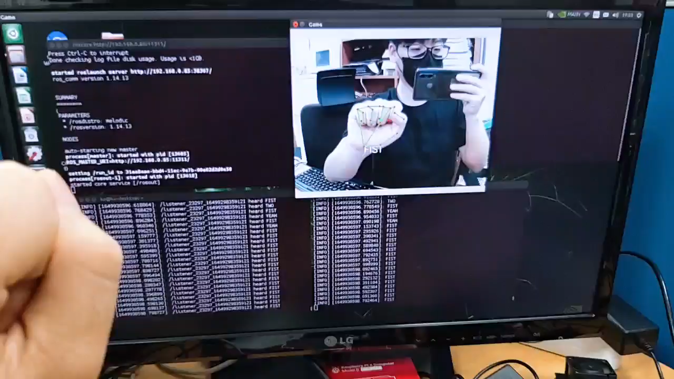
ROS

